Slide 1
DevOps with Visual studio and Microsoft Azure
get the most out of your msdn, visual studio online, and azure subscriptions

Slide 2

WHATS THE GOAL?
Help developers re-imagine their development workflows using msdn, Visual Studio, Visual Studio Online and Microsoft Azure
Notes:
The goal of these sessions is to help developers get more out of their MSDN, Visual Studio Online, and Azure subscriptions. Of course, if developers aren’t currently MSDN subscribers, they can still benefit from Visual Studio Online and Azure, but they will get to the point where it costs them real dollars quicker because they don’t have the free usage credits that MSDN subscribers do.
This is also a great opportunity to help developers looking to build apps or software to get into BizSpark

Slide 3
“Do it Faster, Better and with more Reliability!”
Notes:
The combination of Visual Studio, Visual Studio Online, and Azure give the modern Microsoft developer an unprecedented set of tools to help them develop their software faster, with better quality, and more reliability. Hopefully the things we show in this session will highlight features of

Slide 4

Get the files from github
You can grab a copy of the slides and demos here: http://aka.ms/AzureDevOpsVSOZip
Or the fork the GitHub repo at:
http://aka.ms/AzureDevOpsVSO

Slide 5
Check out the videos
You can watch pre-recorded versions of this content online:
http://aka.ms/AzureDevOpsVSOVids

Slide 6
agenda
Overview
Creating Dev/Test VMs in Azure
Continuous Deployment with Visual Studio Online and Azure Websites
Monitoring web apps with Application Insights
Load Testing your Web Applications using Visual Studio Online

Slide 7
Overview
Quick overview of Azure, Visual Studio Online and MSDN

Slide 8
WHAT IS Microsoft azure?
ALL ITEMS
WEB SITES
7
VIRTUAL MACHINES
2
MOBILE SERVICES
10
CLOUD SERVICES
7
Run your code
Store your data
Build virtual networks
Authenticate your users
Leverage our application services
All in our data centers!
SQL DATABASES
11
STORAGE
9
HDINSIGHT
0
MEDIA SERVICES
1
SERVICE BUS
1
BIZTALK SERVICES
0
SQL REPORTING
1
NETWORKS
0
TRAFFIC MANAGER
0
MANAGEMENT SERVICES
0
ACTIVE DIRECTORY
2
ADD-ONS2
1
SETTINGS
1

Slide 9
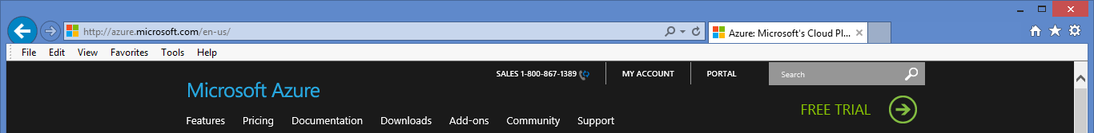
Just want to try it out?
Go to azure.microsoft.com and click the “FREE TRIAL” link
30 Days or $200 of Usage, whichever comes first
A credit card is required to sign up (for identification purposes)
Nothing will be charged, unless you remove the spending limit

Slide 10
Msdn subscriber azure benefits
Not just free usage, but discounted prices as well!
Subscription Level | Visual Studio Professional with MSDN | Visual Studio Test Professional with MSDN | MSDN Platforms | Visual Studio Premium with MSDN | Visual Studio Ultimate with MSDN
Azure Credits per Month | $50 | $50 | $100 | $100 | $150
1st Year Annual Savings | $600+ | $600+ | $1200+ | $1200+ | $1800+
Learn more here: http://www.windowsazure.com/en-us/pricing/member-offers/msdn-benefits-details/

Slide 11
Don’t have MSDN? Are you a startup?
ASK ME HOW!
ASK ME HOW!
Is your business:
Developing software or apps?
Less than 5 years old and privately held?
Making less than US$1M annually?
Got a business email address and website?
Get MSDN, Azure and tons more for Free!
http://bizspark.com

Slide 12

Cloud Based Team Foundation Service (TFS)
Unlimited Team Projects
Work Item Tracking
Backlogs
Bug Tracking
Source Control using TFS or GIT repositories
Cloud Based Build Server for CI Builds
Cloud Based Load Testing
Application Insights for Application Monitoring

Slide 13
Yeah, but what does it cost?
First five “Basic” users per subscription are free
Additional “Basic” users are $20/month
“Professional” users cost $45/month
“Advanced” users cost $60/month
Existing MSDN subscribers can be added at no cost
You get 60 Build Minutes per Month.
Additional Build Minutes cost $0.025 / minute
You get 15,000 Virtual User Minutes for Load Testing per Month
Additional Virtual User Minutes cost $.001 / minute
Learn More Here: http://www.visualstudio.com/products/visual-studio-online-overview-vs

Slide 14
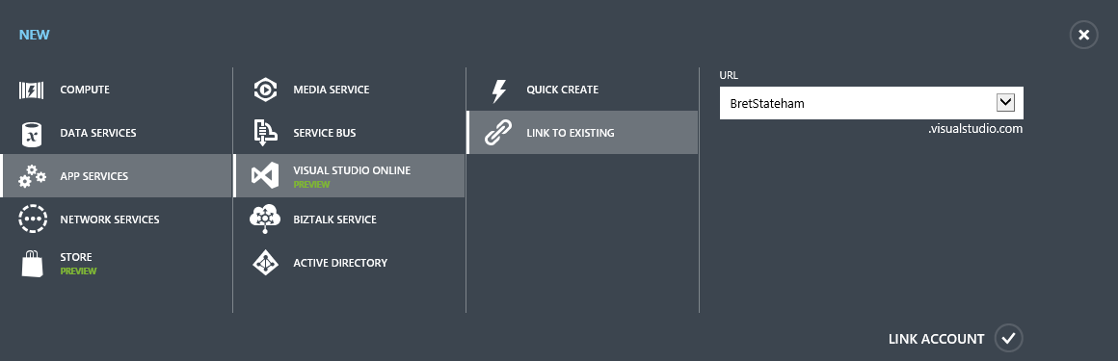
How do I setup the billing
Sign into a paid Azure (not a free MSND Azure Benefit) account, and click “+NEW” | “APP SERVICES” | “VISUAL STUDIO ONLINE” | “LINK TO EXISTING”

Slide 15
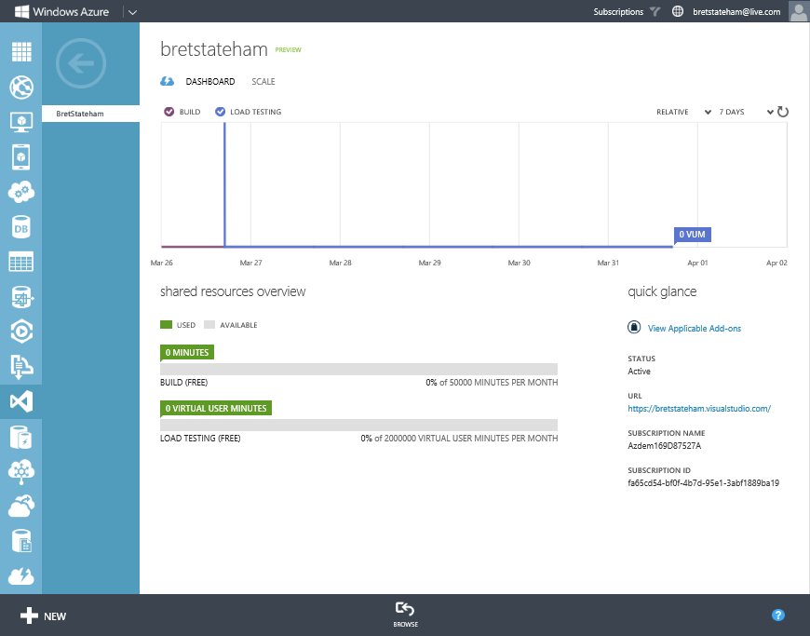
Once linked, you can monitor

Slide 16
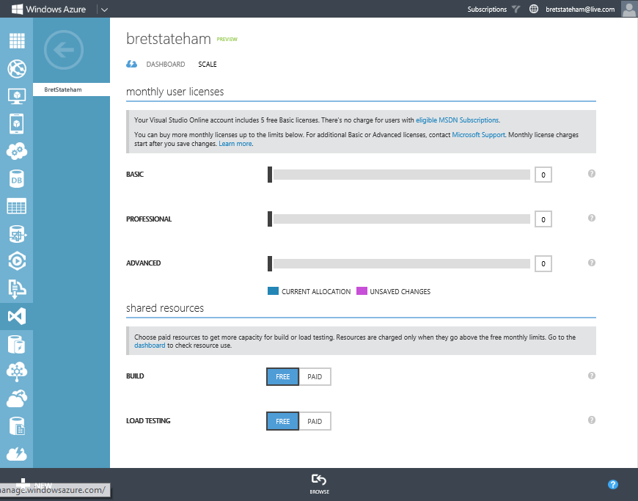
And manage your accounts

Slide 17
Dev/Test VMs in Azure

Slide 18
The scenarios
Creating Dev/Test VMs in Azure
Continuous Deployment with Visual Studio Online and Azure Websites
Monitoring web apps with Application Insights
Load Testing your Web Applications using Visual Studio Online

Slide 19













Run the Server OS and software you want

Slide 20
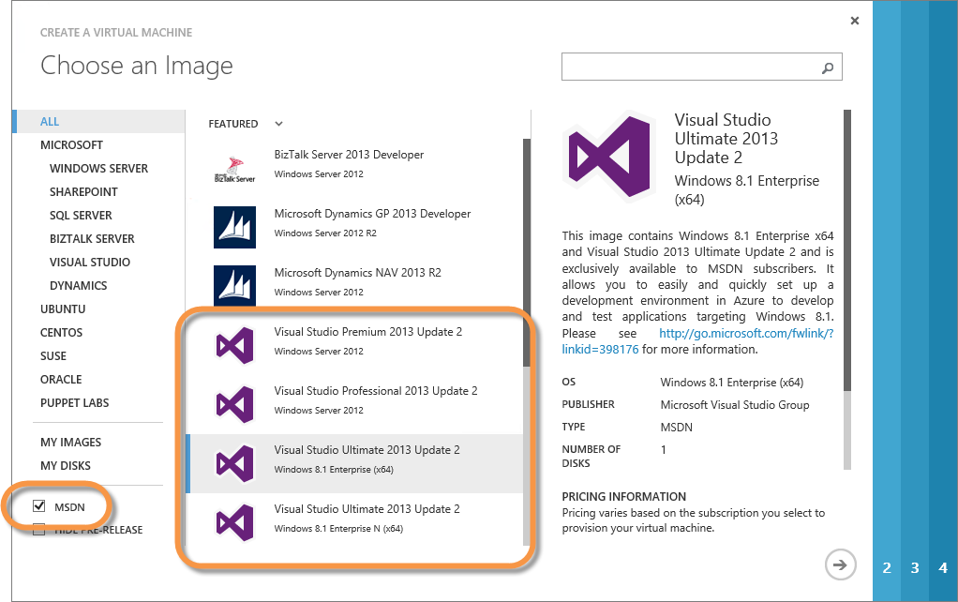
Msdn visual studio 2013 gallery image
Available for MSDN Subscribers only.
Not an MSDN Subscriber? No problem, just create a Windows Server VM and install a Visual Studio Eval for yourself. These now include Windows 8.1 and Windows 7 Client OS Images as well!

Slide 21
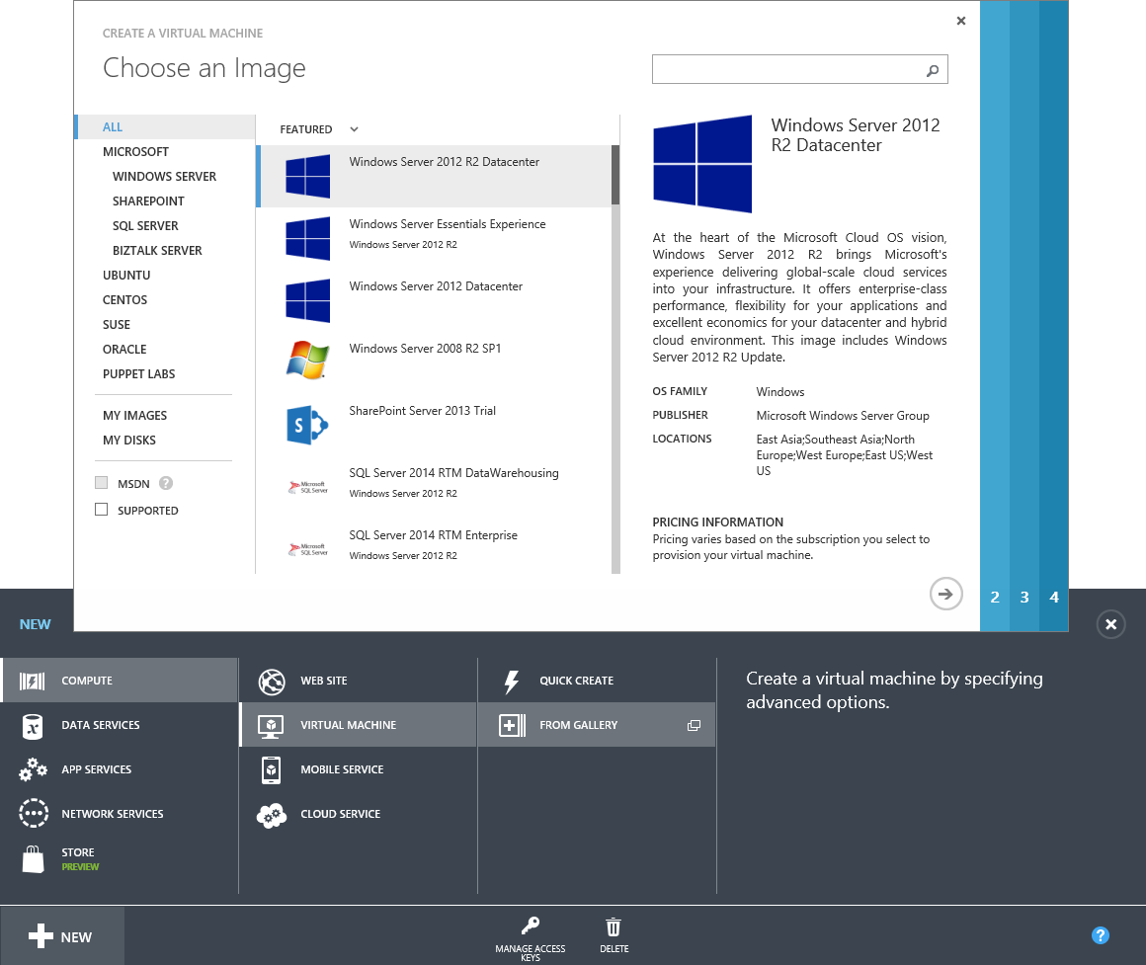
Create in the portal, Powershell, code, or with automation Tools…

Slide 22
Create in the portal, Powershell, code, or with automation Tools…
$iisvm1Config = New-AzureVMConfig -Name “iisvm1" -InstanceSize "Small" -ImageName $webnodeimage.ImageName |
Add-AzureProvisioningConfig -Windows -AdminUsername "devcamp" -Password "Azure`$123" |
Add-AzureEndpoint -LBSetName "webport" -Name "http" -Protocol tcp -PublicPort 80
-LocalPort 80 -ProbePort 80 -ProbeProtocol http -ProbePath '/'
$iisvm2Config = New-AzureVMConfig -Name "iisvm2" -InstanceSize "Small" -ImageName $webnodeimage.ImageName |
Add-AzureProvisioningConfig -Windows -AdminUsername "devcamp" -Password "Azure`$123" |
Add-AzureEndpoint -LBSetName "webport" -Name "http" -Protocol tcp -PublicPort 80
-LocalPort 80 -ProbePort 80 -ProbeProtocol http -ProbePath '/'
$sqlvm1Config = New-AzureVMConfig -Name "sqlvm1" -InstanceSize "Small" -ImageName $sqlnodeimage.ImageName |
Add-AzureProvisioningConfig -Windows -AdminUsername "devcamp" -Password "Azure`$123" |
Add-AzureDataDisk -CreateNew -DiskSizeInGB 50 -DiskLabel "SQLDataDisk" -LUN 0 |
Add-AzureDataDisk -CreateNew -DiskSizeInGB 50 -DiskLabel "SQLLogDisk" -LUN 1
New-AzureService -ServiceName $ServiceName -Location "West US"
New-AzureVM -ServiceName $ServiceName -VMs $iisvm1Config, $iisvm2Config, $sqlvm1Config

Slide 23


Create in the portal, Powershell, code, or with automation Tools…
Azure Automation

Slide 24
Virtual machine portability
Azure Data Center
VHD
VHD
VHD
Use the Add-AzureVhd PowerShell CmdLet to upload. Download it using the tool of your choice. You can also opt to use our physical Import/Export service.
On Premises
VHD
VHD
VHD

Slide 25
Create a Dev/Test VM in Azure

Slide 26
Continuous deployment with VSO and Azure

Slide 27
The scenarios
Creating Dev/Test VMs in Azure
Continuous Deployment with Visual Studio Online and Azure Websites
Monitoring web apps with Application Insights
Load Testing your Web Applications using Visual Studio Online

Slide 28
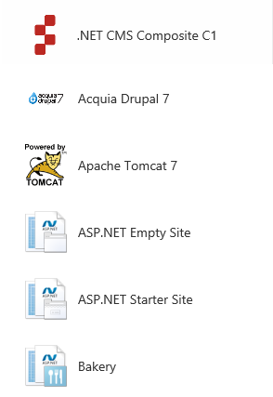
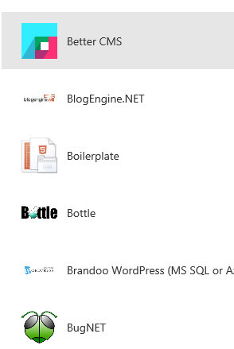
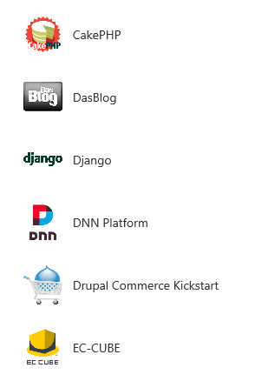
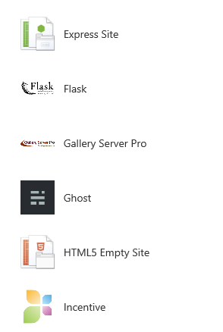
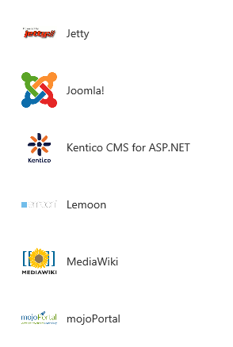
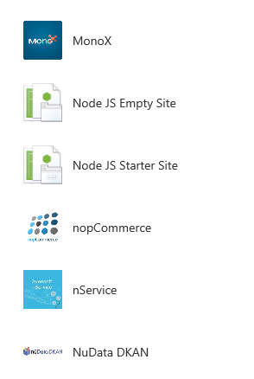
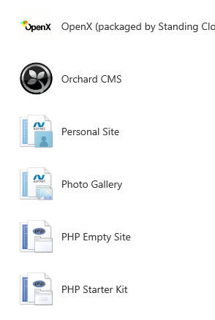
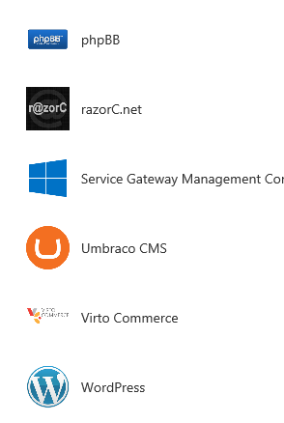
Azure websites
This isn’t “Web Hosting”, it is a fully scalable, manageable, production level web platform!
Support for the Microsoft stack as well as a number of other platforms including… Node.JS
PHP Tomcat / Java
And a ton of Blog, CMS, Wiki, etc. templates…

Slide 29
Continuous deployment
2
Create an Azure Web Site and Link it to the Team Project
5
VSO Build runs and deploys the website to Azure
1
Create a Team Project in Visual Studio Online
4
Check-in your web site source code
3
Create your web site in visual studio

Slide 30
Continuous Deployment with Visual Studio Online and Azure Websites

Slide 31
Monitoring with Application Insights

Slide 32
The scenarios
Creating Dev/Test VMs in Azure
Continuous Deployment with Visual Studio Online and Azure Websites
Monitoring web apps with Application Insights
Load Testing your Web Applications using Visual Studio Online

Slide 33

Application insights
Find out what your users are doing with your:
Web Site
Windows App
Windows Phone App
Make Sure your Web Site / Service is available and responsive
Quickly diagnose performance issues or exceptions.

Slide 34
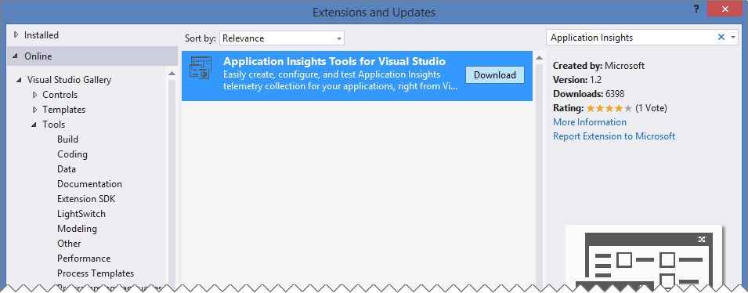
Install the Application insights tools for Visual Studio

Slide 35
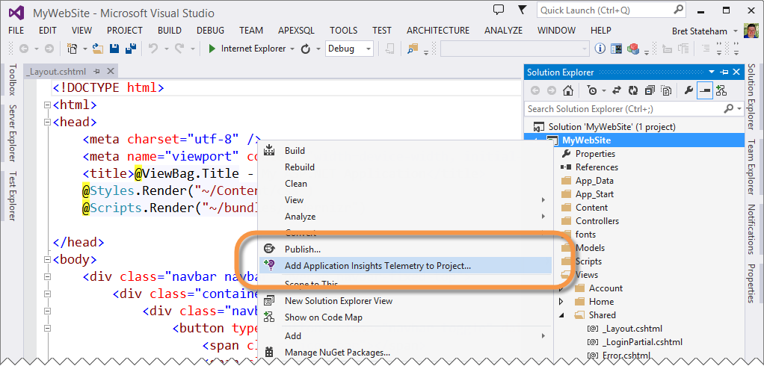
Add application insights to an existing project…

Slide 36
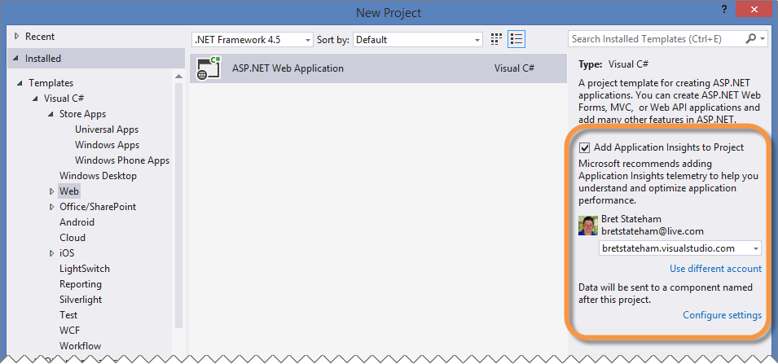
Or add it when creating a new project

Slide 37
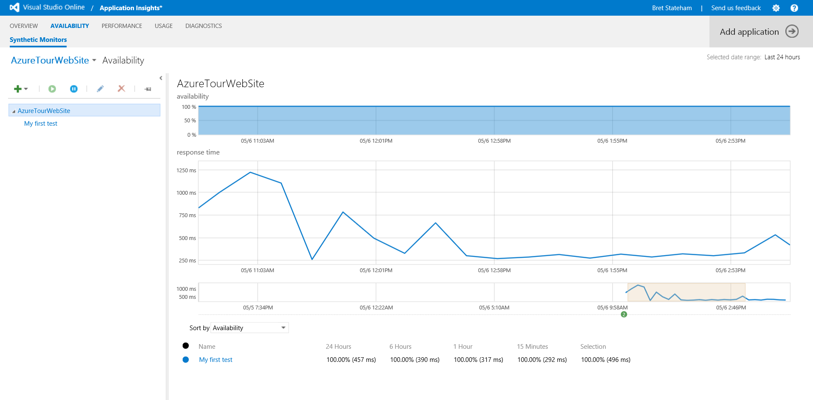
Monitor via dashboard

Slide 38
Monitoring applications with Application Insights

Slide 39
Load Testing with Visual studio Online

Slide 40
The scenarios
Creating Dev/Test VMs in Azure
Continuous Deployment with Visual Studio Online and Azure Websites
Monitoring web apps with Application Insights
Load Testing your Web Applications using Visual Studio Online

Slide 41
Load testing
1
Record a Web Performance Test (link)
2
Create and run a load test (link)
3
Edit the Solution’s Local.testsettings to use Visual Studio Online
4
Run the Load Test on Visual Studio Online
5
Download the Report for Analysis

Slide 42
Load Testing your Web Applications using Visual Studio Online

Slide 43
review
Overview
Creating Dev/Test VMs in Azure
Continuous Deployment with Visual Studio Online and Azure Websites
Monitoring web apps with Application Insights
Load Testing your Web Applications using Visual Studio Online

Slide 44

Go do
A Startup? Sign up for BizSpark! Ask me for an enrollment code to expedite it!
Create an Azure Account by signing up for a free trial, or using your MSDN benefit
Create a Visual Studio Online Account at visualstudio.com
Get Started!

Slide 45
Get the files from github
You can grab a copy of the slides and demos here: http://aka.ms/AzureDevOpsVSOZip
Or the GitHub Repo at:
http://aka.ms/AzureDevOpsVSO

Slide 46
Links
Want something more intense? Try out Jeff Fattic’s “Continuous Delivery with Visual Studio” http://1drv.ms/NoB5nN
Windows Client images for MSDN subscribers http://azure.microsoft.com/blog/2014/05/29/windows-client-images-on-azure/
Visual Studio Online User Plans http://www.visualstudio.com/en-us/products/visual-studio-online-overview-vs.aspx
Application Insights for Visual Studio Online http://msdn.microsoft.com/en-us/library/dn481095.aspx
Application Insights Tools for Visual Studio http://visualstudiogallery.msdn.microsoft.com/82367b81-3f97-4de1-bbf1-eaf52ddc635a
Web Performance and Load Testing http://msdn.microsoft.com/en-us/library/dn250793.aspx
Get more build or load testing capacity for your account: http://www.visualstudio.com/en-us/get-started/get-more-build-or-load-testing-vs.aspx

Slide 47
COLORS
R 62 G 168
B 245
R 113
G 177
B 209
R 60 G 69 B 79
R 140
G 197
B 61
R 106
G 196
B 234
R 136
G 142
B 148
R 255
G 142
B 0
R 255
G 243
B 251
R 236
G 34
B 118

Slide 48
TILES

